Slide 1
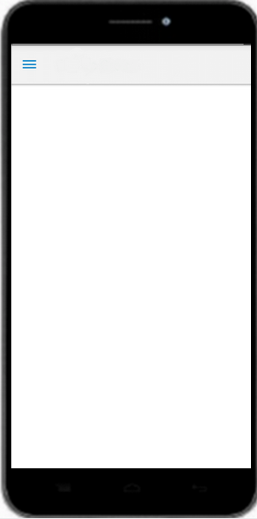



Type 'create' in the bot to create chatlet
Type 'create' in the Bot
Chatlet creator
Me . 06 Jul
create
Pocket. 06 Jul
Click on this button to create chatlet
Posted on: 06 Jul 2015 12:25PM IS

Slide 2
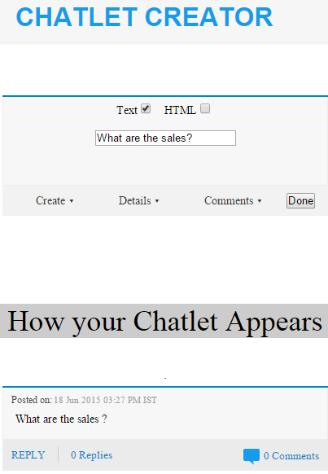


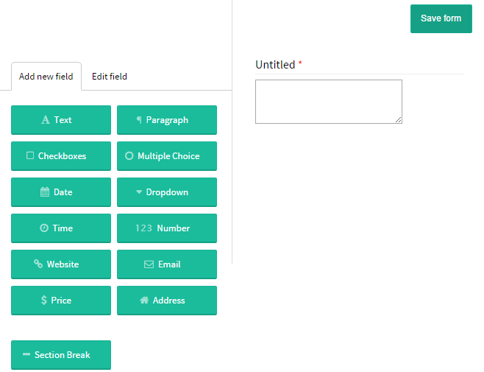
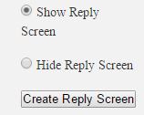
Reply
You can choose show or hide yor reply screen, Details, Comments by choosing options from respective dropdown
Save your form from here
Edit your form here
From dropdown 'Create' click here on 'Create Reply screen'.
Drag and drop these options on right hand side to design your Reply form
This is how your chatlet will appear

Slide 3
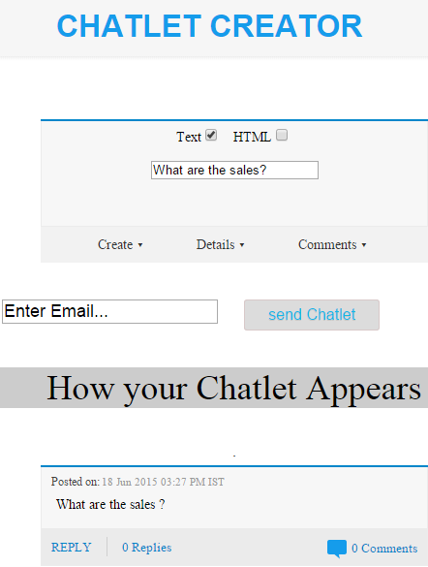
Once you are done with designing your chatlet click on 'Done'
After clicking on Done this field will appear.Write email whom you want to send your chatlet

